Slide 1
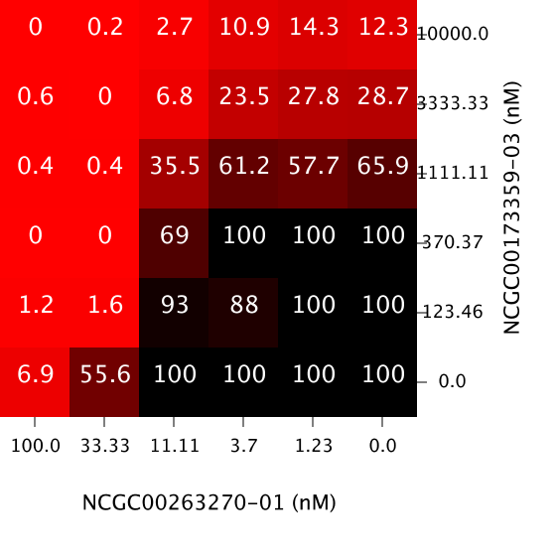
Drug Combinations- Response Matrices

Slide 2
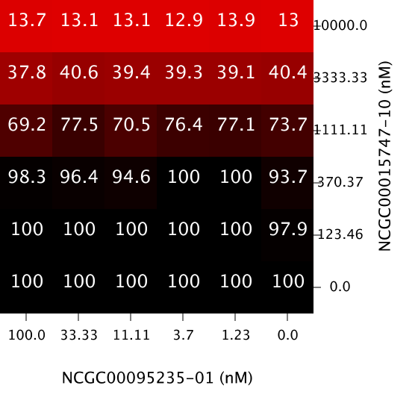
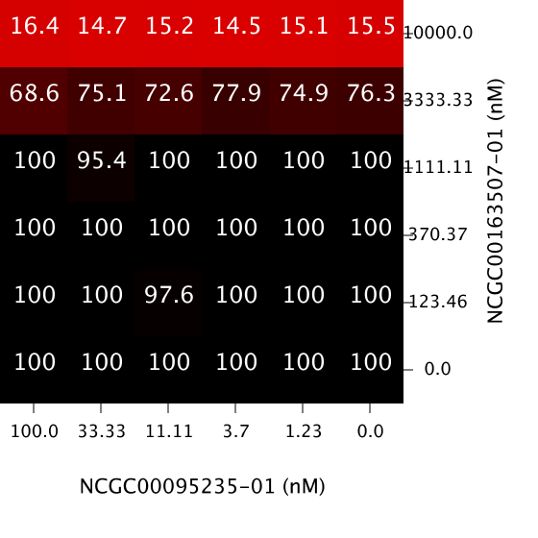
Drug Combinations- Response Matrices

Slide 3
Questions
Does the similarity of the matrices correlate to how similar the drugs themselves are?
Does the similarity of the matrices correlate to the pathways they target?
Do combinations with similar response matrices have similar synergy matrices?

Slide 4
Measuring Similarity Between Matrices
Root Mean Square Error (RMSE)
Euclidean Distance
Kolmogorov Smirnov test (KS test)
Syrjala Distance
How to take into account spatial distribution?

Slide 5
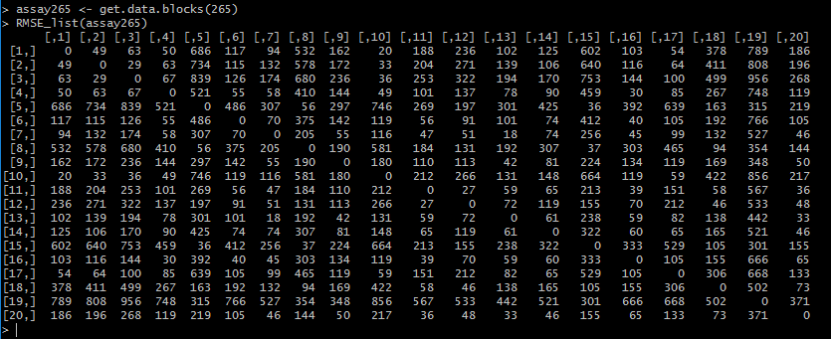
Calculating Similarity- RMSE
Compare response matrices in assay to all other response matrices

Slide 6
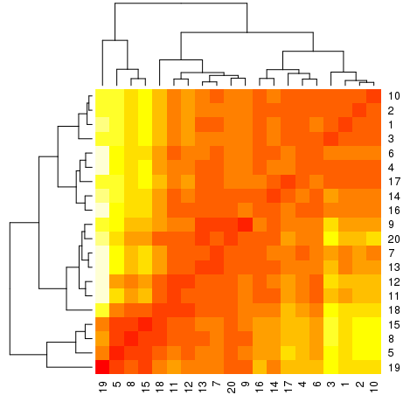
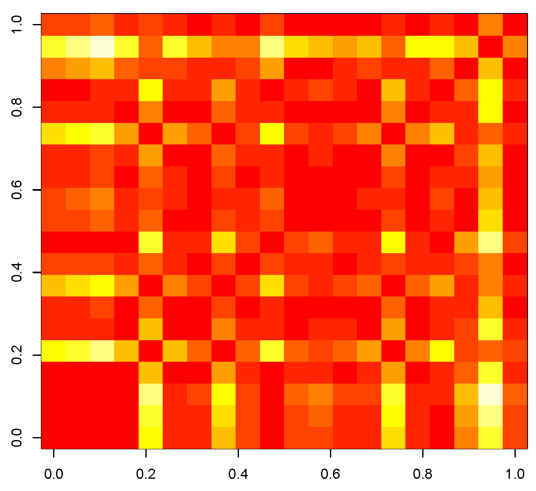
Heatmap and Clustering- RMSE

Slide 7
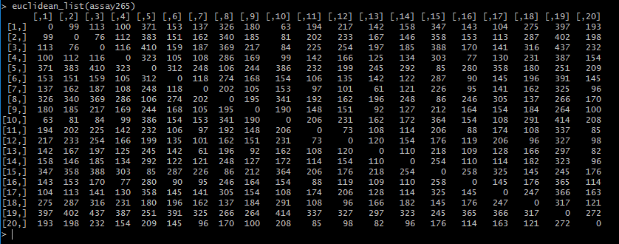
Calculating Similarity- Euclidean Distance
Compare response matrices in assay to all other response matrices

Slide 8
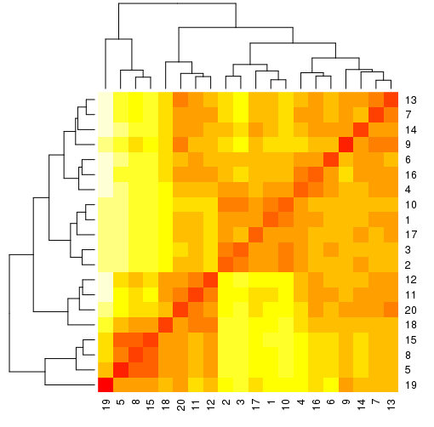
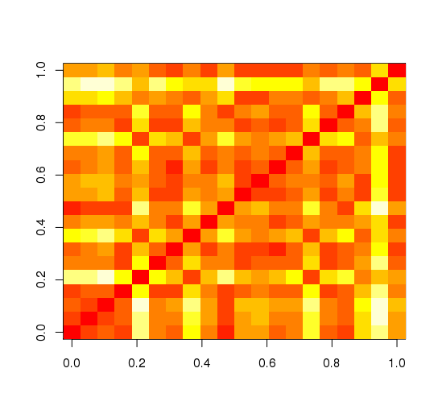
Heatmap and Clustering- Euclidean Distance

Slide 9
RMSE
Euclidean Distance

Slide 10
RMSE
Euclidean Distance

Slide 11
Future Work
Short Term:
Functions for KS test and Syrjala test
Calculating the distance between matrices- taking into account spatial distribution

Slide 12
Future Work
Long Term: Question 1
see if there is any correlation between similarity of chemicals and similarity of the response matrices

Slide 13
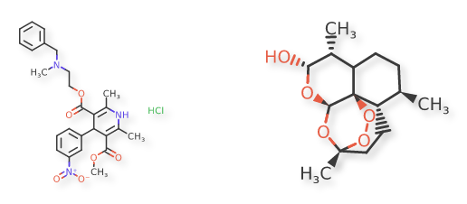
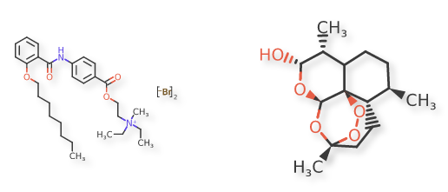
Future Work
Long Term: Question 1
see if there is any correlation between similarity of chemicals and similarity of the response matrices

Slide 14
Future Work
Long Term: Question 3
see if similar response matrices have similar synergy matrices

Slide 15
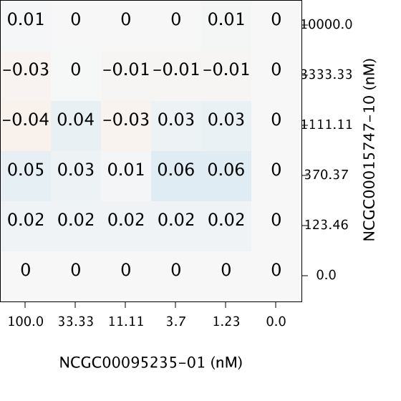
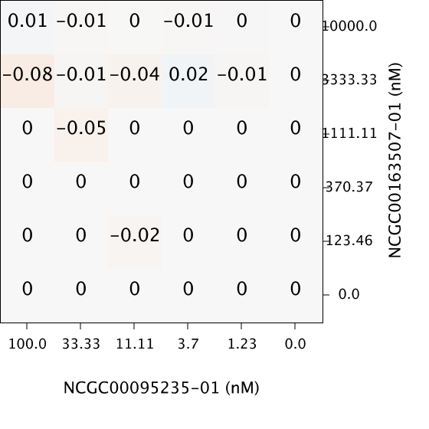
Future Work
Long Term: Question 3
see if similar response matrices have similar synergy matrices

